Slide 1

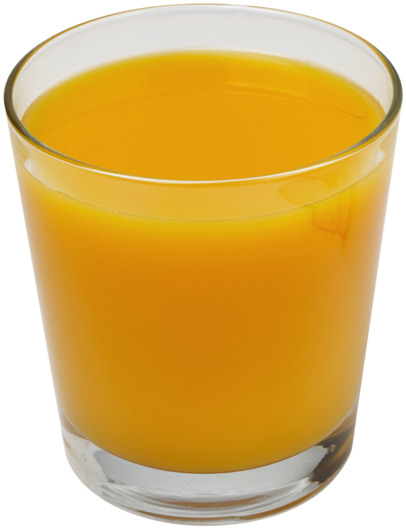

Analysis of Algorithms
Input
Algorithm
Output
© 2013 Goodrich, Tamassia, Goldwasser
Analysis of Algorithms

Slide 2

Running Time
Most algorithms transform input objects into output objects.
The running time of an algorithm typically grows with the input size.
Average case time is often difficult to determine.
We focus on the worst case running time.
  Easier to analyze
  Crucial to applications such as games, finance and robotics
© 2013 Goodrich, Tamassia, Goldwasser
Analysis of Algorithms

Slide 3

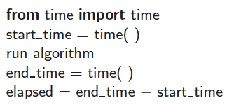
Experimental Studies
Write a program implementing the algorithm
Run the program with inputs of varying size and composition, noting the time needed:
Plot the results
© 2013 Goodrich, Tamassia, Goldwasser
Analysis of Algorithms

Slide 4

Limitations of Experiments
It is necessary to implement the algorithm, which may be difficult
Results may not be indicative of the running time on other inputs not included in the experiment.
In order to compare two algorithms, the same hardware and software environments must be used
© 2013 Goodrich, Tamassia, Goldwasser
Analysis of Algorithms

Slide 5

Theoretical Analysis
Uses a high-level description of the algorithm instead of an implementation
Characterizes running time as a function of the input size, n.
Takes into account all possible inputs
Allows us to evaluate the speed of an algorithm independent of the hardware/software environment
© 2013 Goodrich, Tamassia, Goldwasser
Analysis of Algorithms

Slide 6
Pseudocode
High-level description of an algorithm
More structured than English prose
Less detailed than a program
Preferred notation for describing algorithms
Hides program design issues
© 2013 Goodrich, Tamassia, Goldwasser
Analysis of Algorithms

Slide 7
Pseudocode Details
Control flow
  if … then … [else …]
  while … do …
  repeat … until …
  for … do …
  Indentation replaces braces
Method declaration
  Algorithm method (arg [, arg…])
  Input …
  Output …
Method call
  method (arg [, arg…])
Return value
  return expression
Expressions:
  Assignment
  Equality testing
  n² Superscripts and other mathematical formatting allowed
© 2013 Goodrich, Tamassia, Goldwasser
Analysis of Algorithms

Slide 8
The Random Access Machine (RAM) Model
A CPU
An potentially unbounded bank of memory cells, each of which can hold an arbitrary number or character
2
1
0
Memory cells are numbered and accessing any cell in memory takes unit time.
© 2013 Goodrich, Tamassia, Goldwasser
Analysis of Algorithms

Slide 9
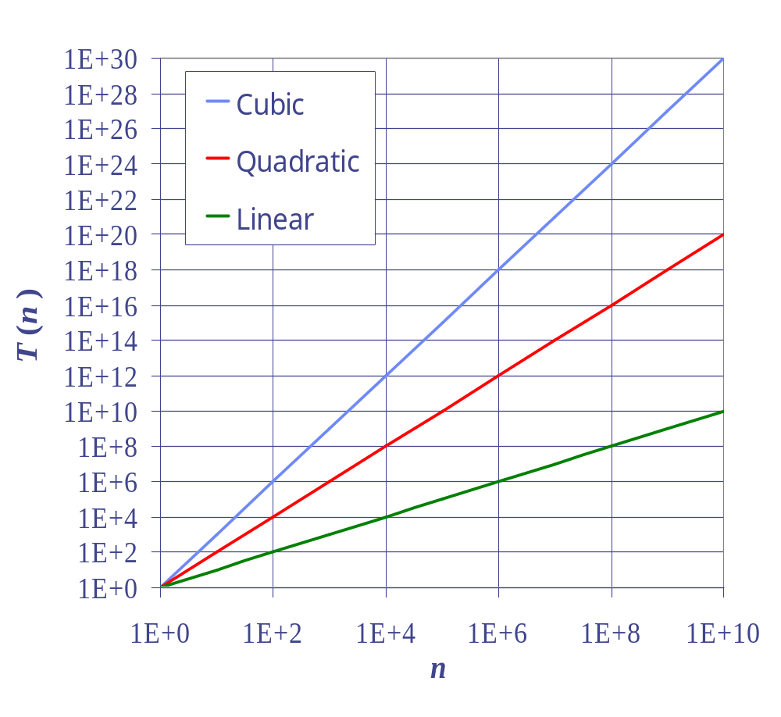
Seven Important Functions
Seven functions that often appear in algorithm analysis:
  Constant ≈ 1
  Logarithmic ≈ log n
  Linear ≈ n
  N-Log-N ≈ n log n
  Quadratic ≈ n²
  Cubic ≈ n³
  Exponential ≈ 2^{n}
In a log-log chart, the slope of the line corresponds to the growth rate
© 2013 Goodrich, Tamassia, Goldwasser
Analysis of Algorithms

Slide 10
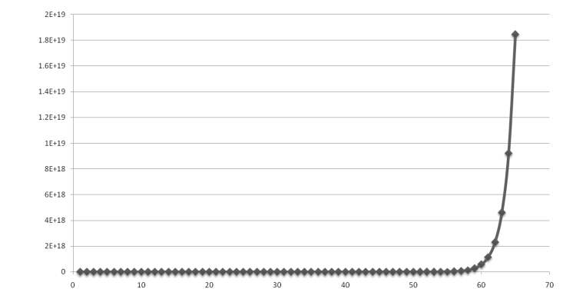
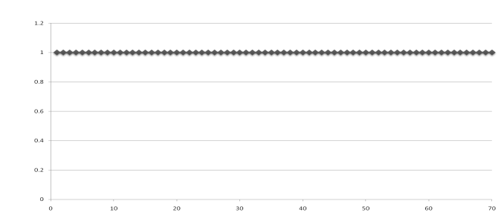
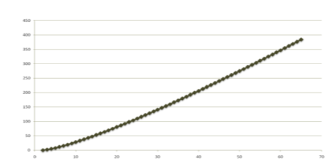
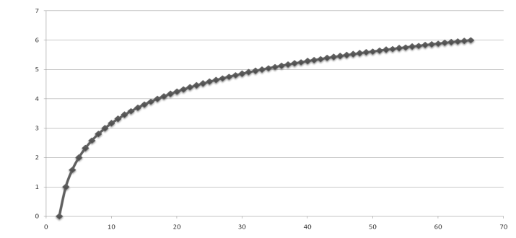
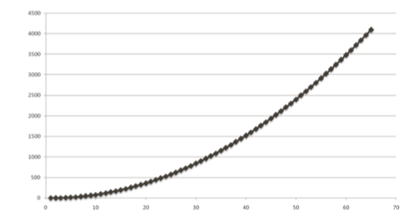
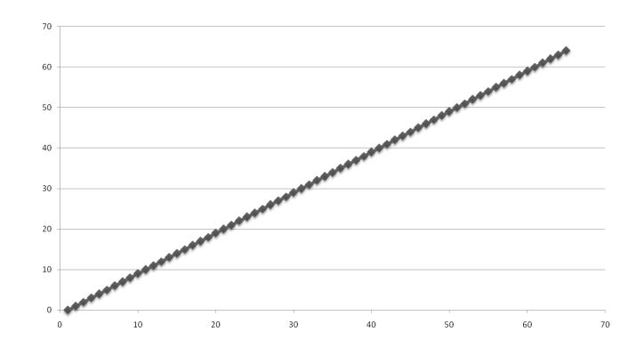
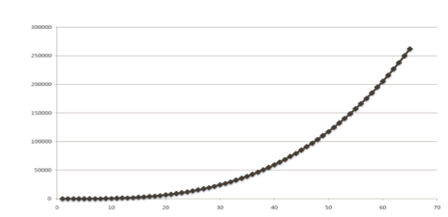
Functions Graphed
Using “Normal” Scale
Slide by Matt Stallmann included with permission.
g(n) = n lg n
g(n) = 1
g(n) = 2^{n}
g(n) = n²
g(n) = lg n
g(n) = n
g(n) = n³
© 2013 Goodrich, Tamassia, Goldwasser
Analysis of Algorithms

Slide 11

Primitive Operations
Basic computations performed by an algorithm
Identifiable in pseudocode
Largely independent from the programming language
Exact definition not important (we will see why later)
Assumed to take a constant amount of time in the RAM model
Examples:
  Evaluating an expression
  Assigning a value to a variable
  Indexing into an array
  Calling a method
  Returning from a method
© 2013 Goodrich, Tamassia, Goldwasser
Analysis of Algorithms

Slide 12
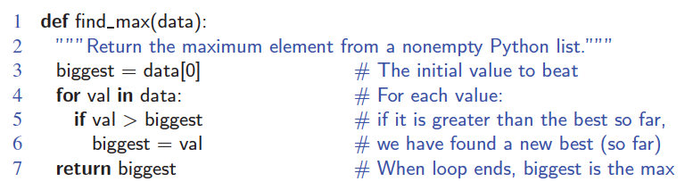
Counting Primitive Operations
By inspecting the pseudocode, we can determine the maximum number of primitive operations executed by an algorithm, as a function of the input size
Step 1: 2 ops, 3: 2 ops, 4: 2n ops, 5: 2n ops, 6: 0 to n ops, 7: 1 op
© 2013 Goodrich, Tamassia, Goldwasser
Analysis of Algorithms

Slide 13

Estimating Running Time
Algorithm find_max executes 5n + 5 primitive operations in the worst case, 4n + 5 in the best case. Define:
  a = Time taken by the fastest primitive operation
  b = Time taken by the slowest primitive operation
Let T(n) be worst-case time of find_max. Then
a (4n + 5) ≤ T(n) ≤ b(5n + 5)
Hence, the running time T(n) is bounded by two linear functions.
© 2013 Goodrich, Tamassia, Goldwasser
Analysis of Algorithms

Slide 14

Growth Rate of Running Time
Changing the hardware/ software environment
  Affects T(n) by a constant factor, but
  Does not alter the growth rate of T(n)
The linear growth rate of the running time T(n) is an intrinsic property of algorithm find_max
© 2013 Goodrich, Tamassia, Goldwasser
Analysis of Algorithms

Slide 15
Why Growth Rate Matters
Slide by Matt Stallmann included with permission.
if runtime is... | time for n + 1 | time for 2 n | time for 4 n
c lg n | c lg (n + 1) | c (lg n + 1) | c(lg n + 2)
c n | c (n + 1) | 2c n | 4c n
c n lg n | ~ c n lg n + c n | 2c n lg n + 2cn | 4c n lg n + 4cn
c n² | ~ c n² + 2c n | 4c n² | 16c n²
c n³ | ~ c n³ + 3c n² | 8c n³ | 64c n³
c 2^{n} | c 2 ^{n+1} | c 2 ^{2n} | c 2 ^{4n}
runtime
quadruples
when problem
size doubles
© 2013 Goodrich, Tamassia, Goldwasser
Analysis of Algorithms

Slide 16
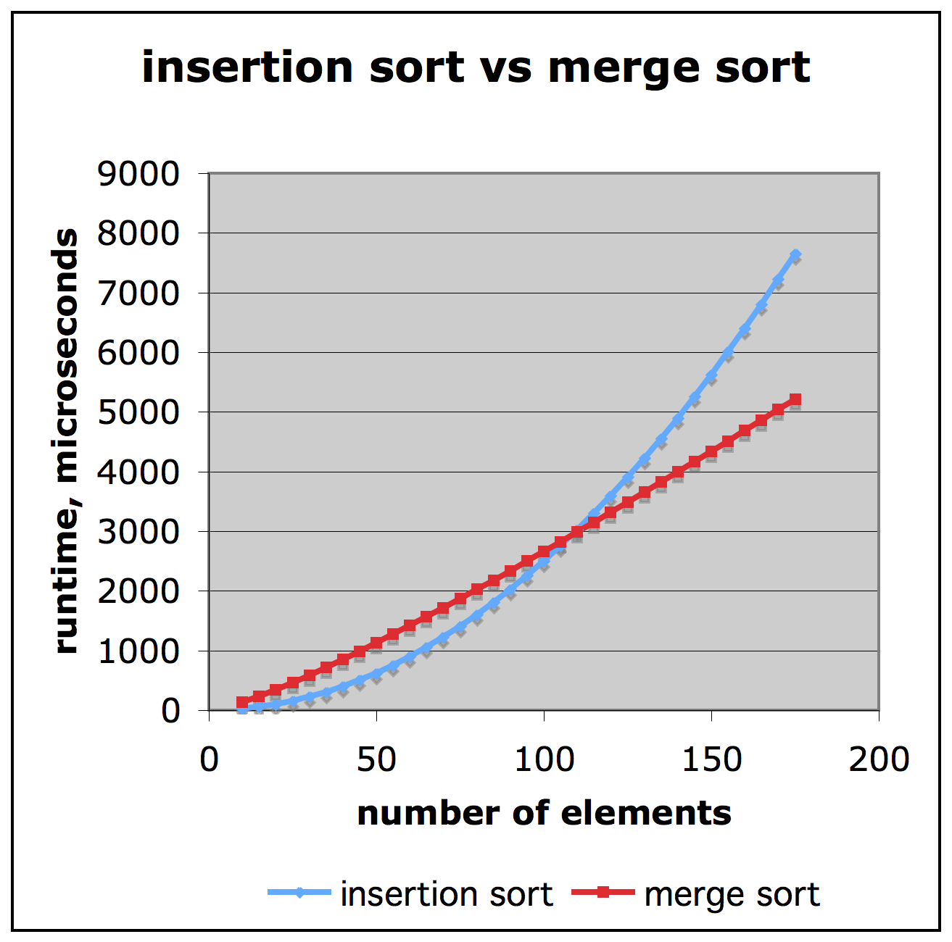
Comparison of Two Algorithms
Slide by Matt Stallmann included with permission.
insertion sort is
n² / 4
merge sort is
2 n lg n
sort a million items?
insertion sort takes
roughly 70 hours
while
merge sort takes
roughly 40 seconds
This is a slow machine, but if
100 x as fast then it’s 40 minutes
versus less than 0.5 seconds
© 2013 Goodrich, Tamassia, Goldwasser
Analysis of Algorithms

Slide 17
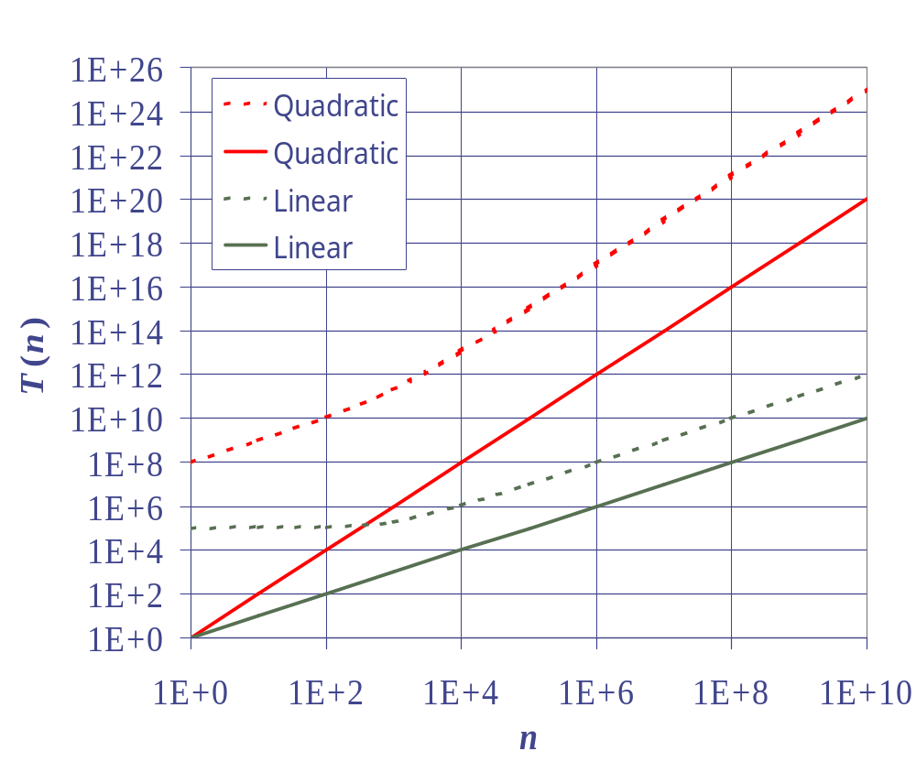
Constant Factors
The growth rate is not affected by
  constant factors or
  lower-order terms
Examples
  10²n + 10⁵ is a linear function
  10⁵n² + 10⁸n is a quadratic function
© 2013 Goodrich, Tamassia, Goldwasser
Analysis of Algorithms

Slide 18
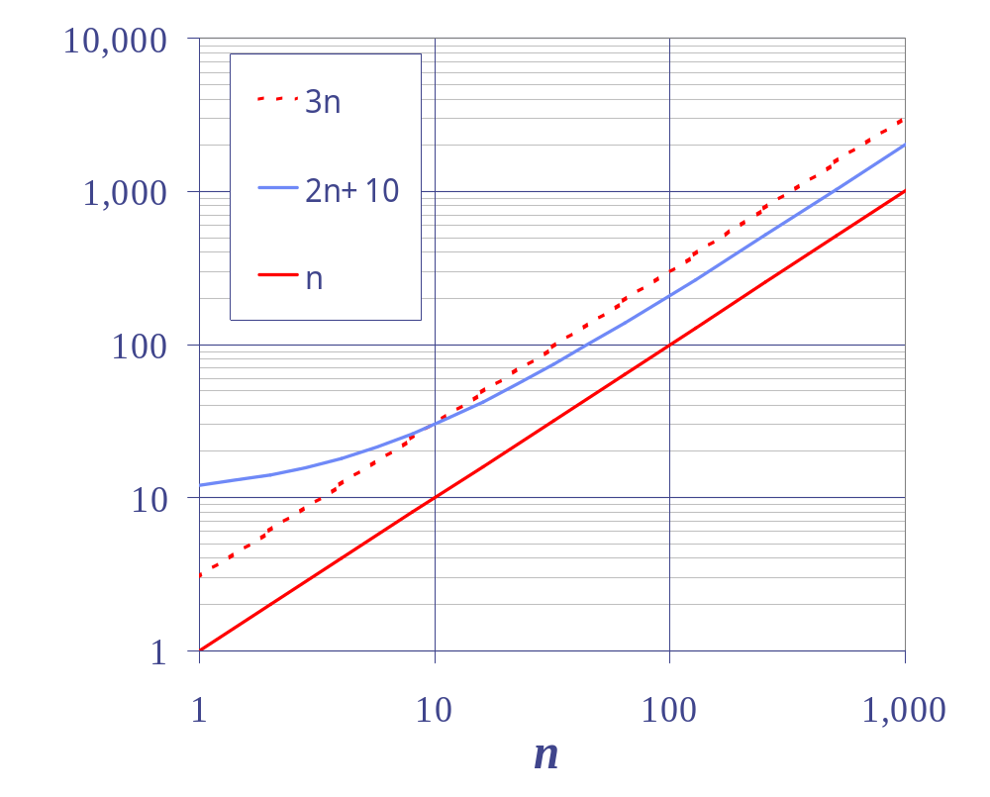
Big-Oh Notation
Given functions f(n) and g(n), we say that f(n) is O(g(n)) if there are positive constants
c and n₀ such that
f(n) ≤ cg(n) for n ≥ n₀
Example: 2n + 10 is O(n)
  2n + 10 ≤ cn
  (c − 2) n ≥ 10
  n ≥ 10/(c − 2)
  Pick c = 3 and n₀ = 10
© 2013 Goodrich, Tamassia, Goldwasser
Analysis of Algorithms

Slide 19
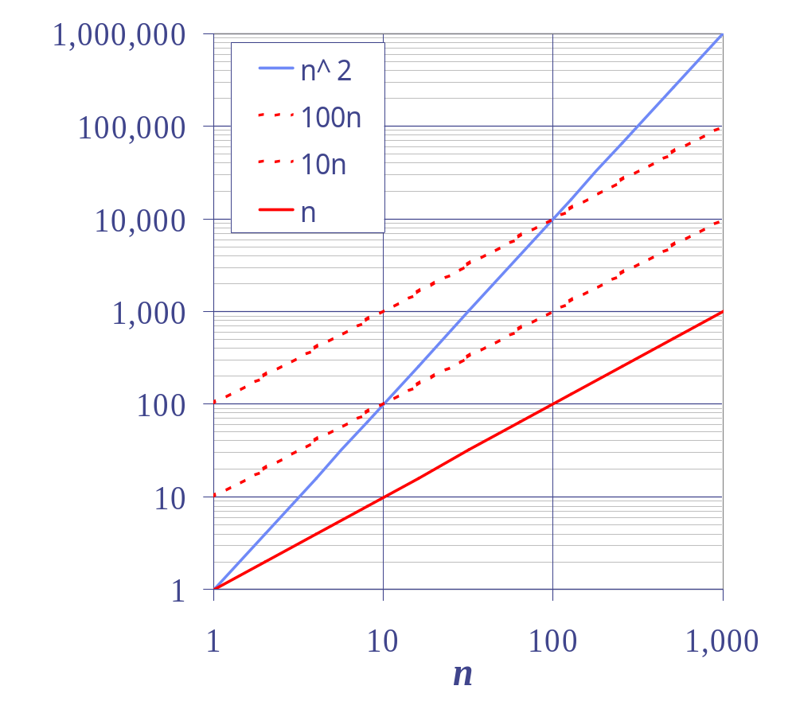
Big-Oh Example
Example: the function n² is not O(n)
  n² ≤ cn
  n ≤ c
  The above inequality cannot be satisfied since c must be a constant
© 2013 Goodrich, Tamassia, Goldwasser
Analysis of Algorithms

Slide 20


More Big-Oh Examples
7n-2
  7n-2 is O(n)
  need c > 0 and n₀ ≥ 1 such that 7n-2 ≤ c•n for n ≥ n₀
  this is true for c = 7 and n₀ = 1
3n³ + 20n² + 5
  3n³ + 20n² + 5 is O(n³)
  need c > 0 and n₀ ≥ 1 such that 3n³ + 20n² + 5 ≤ c•n³ for n ≥ n₀
  this is true for c = 4 and n₀ = 21
3 log n + 5
  3 log n + 5 is O(log n)
  need c > 0 and n₀ ≥ 1 such that 3 log n + 5 ≤ c•log n for n ≥ n₀
  this is true for c = 8 and n₀ = 2
© 2013 Goodrich, Tamassia, Goldwasser
Analysis of Algorithms

Slide 21
Big-Oh and Growth Rate
The big-Oh notation gives an upper bound on the growth rate of a function
The statement “f(n) is O(g(n))” means that the growth rate of f(n) is no more than the growth rate of g(n)
We can use the big-Oh notation to rank functions according to their growth rate
 | f(n) is O(g(n)) | g(n) is O(f(n))
g(n) grows more | Yes | No
f(n) grows more | No | Yes
Same growth | Yes | Yes
© 2013 Goodrich, Tamassia, Goldwasser
Analysis of Algorithms

Slide 22

Big-Oh Rules
If is f(n) a polynomial of degree d, then f(n) is O(n^{d}), i.e.,
  Drop lower-order terms
  Drop constant factors
Use the smallest possible class of functions
  Say “2n is O(n)” instead of “2n is O(n²)”
Use the simplest expression of the class
  Say “3n + 5 is O(n)” instead of “3n + 5 is O(3n)”
© 2013 Goodrich, Tamassia, Goldwasser
Analysis of Algorithms

Slide 23
Asymptotic Algorithm Analysis
The asymptotic analysis of an algorithm determines the running time in big-Oh notation
To perform the asymptotic analysis
  We find the worst-case number of primitive operations executed as a function of the input size
  We express this function with big-Oh notation
Example:
  We say that algorithm find_max “runs in O(n) time”
Since constant factors and lower-order terms are eventually dropped anyhow, we can disregard them when counting primitive operations
© 2013 Goodrich, Tamassia, Goldwasser
Analysis of Algorithms

Slide 24

Computing Prefix Averages
We further illustrate asymptotic analysis with two algorithms for prefix averages
The i-th prefix average of an array X is average of the first (i + 1) elements of X:
A[i] = (X[0] + X[1] + … + X[i])/(i+1)
Computing the array A of prefix averages of another array X has applications to financial analysis
© 2013 Goodrich, Tamassia, Goldwasser
Analysis of Algorithms

Slide 25
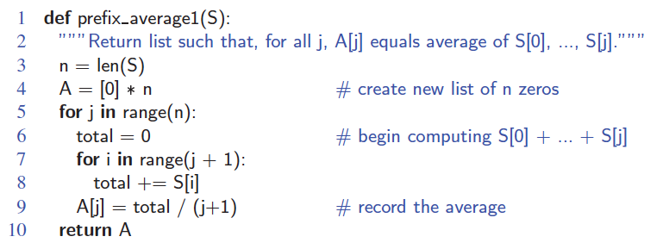
Prefix Averages (Quadratic)
The following algorithm computes prefix averages in quadratic time by applying the definition
© 2013 Goodrich, Tamassia, Goldwasser
Analysis of Algorithms

Slide 26
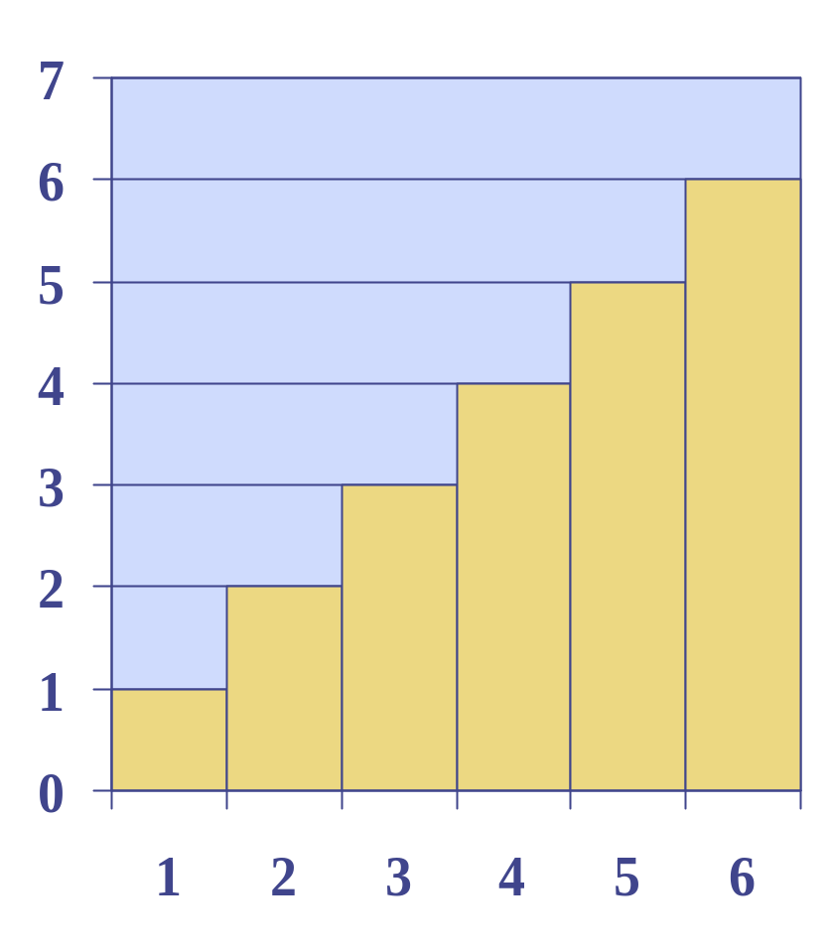
Arithmetic Progression
The running time of prefixAverage1 is
O(1 + 2 + …+ n)
The sum of the first n integers is n(n + 1) / 2
  There is a simple visual proof of this fact
Thus, algorithm prefixAverage1 runs in O(n²) time
© 2013 Goodrich, Tamassia, Goldwasser
Analysis of Algorithms

Slide 27
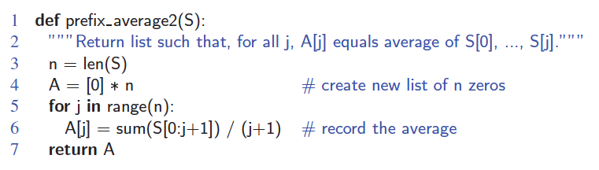
Prefix Averages 2 (Looks Better)
The following algorithm uses an internal Python function to simplify the code
Algorithm prefixAverage2 still runs in O(n²) time!
© 2013 Goodrich, Tamassia, Goldwasser
Analysis of Algorithms

Slide 28
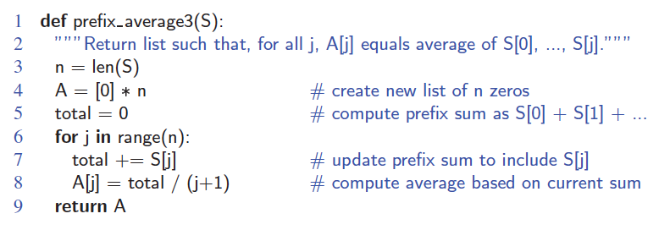
Prefix Averages 3 (Linear Time)
The following algorithm computes prefix averages in linear time by keeping a running sum
Algorithm prefixAverage3 runs in O(n) time
© 2013 Goodrich, Tamassia, Goldwasser
Analysis of Algorithms

Slide 29

Math you need to Review
Summations
Logarithms and Exponents
Proof techniques
Basic probability
properties of logarithms:
  log_{b}(xy) = log_{b}x + log_{b}y
  log_{b} (x/y) = log_{b}x - log_{b}y
  log_{b}xa = alog_{b}x
  log_{b}a = log_{x}a/log_{x}b
properties of exponentials:
  a^{(b+c)} = a^{b}a ^{c}
  a^{bc} = (a^{b})^{c}
  a^{b} /a^{c} = a^{(b-c)}
  b = a ^{log}_{a}^{b}
  b^{c} = a ^{c*log}_{a}^{b}
© 2013 Goodrich, Tamassia, Goldwasser
Analysis of Algorithms

Slide 30

Relatives of Big-Oh
big-Omega
  f(n) is Ω(g(n)) if there is a constant c > 0
  and an integer constant n₀ ≥ 1 such that
  f(n) ≥ c•g(n) for n ≥ n₀
big-Theta
  f(n) is Θ(g(n)) if there are constants c’ > 0 and c’’ > 0 and an integer constant n₀ ≥ 1 such that c’•g(n) ≤ f(n) ≤ c’’•g(n) for n ≥ n₀
© 2013 Goodrich, Tamassia, Goldwasser
Analysis of Algorithms

Slide 31

Intuition for Asymptotic Notation
Big-Oh
  f(n) is O(g(n)) if f(n) is asymptotically less than or equal to g(n)
big-Omega
  f(n) is Ω(g(n)) if f(n) is asymptotically greater than or equal to g(n)
big-Theta
  f(n) is Θ(g(n)) if f(n) is asymptotically equal to g(n)
© 2013 Goodrich, Tamassia, Goldwasser
Analysis of Algorithms

Slide 32

Example Uses of the Relatives of Big-Oh
5n² is Ω(n²)
  f(n) is Ω(g(n)) if there is a constant c > 0 and an integer constant n₀ ≥ 1 such that f(n) ≥ c•g(n) for n ≥ n₀
  let c = 5 and n₀ = 1
5n² is Ω(n)
  f(n) is Ω(g(n)) if there is a constant c > 0 and an integer constant n₀ ≥ 1 such that f(n) ≥ c•g(n) for n ≥ n₀
  let c = 1 and n₀ = 1
5n² is Θ(n²)
  f(n) is Θ(g(n)) if it is Ω(n²) and O(n²). We have already seen the former, for the latter recall that f(n) is O(g(n)) if there is a constant c > 0 and an integer constant n₀ ≥ 1 such that f(n) < c•g(n) for n ≥ n₀
  Let c = 5 and n₀ = 1
© 2013 Goodrich, Tamassia, Goldwasser
Analysis of Algorithms

